Slide 1

DEPARTMENT OF COMPUTER SCIENCE & ENGINEERING
SCHOOL OF COMPUTING
1156CS701- MAJOR PROJECT
INTERNSHIP THROUGH DIND
WINTER SEMESTER(22-23)
REVIEW - I
“WEB-BASED ONLINE DISCUSSION FORUM APPLICATION”
SUPERVISED BY
Dr.Angeline Lydia
Associate Professor
PRESENTED BY
S.MANOJH KUMAR (VTU12596 )(19UECS0586)
E.SHALINI (VTU11514)(19UECS0901)
M.HARINI NESAPRIYA (VTU13669)(19UECS0365)
75

Slide 2
AGENDA
ABSTRACT
OBJECTIVE
INTRODUCTION
LITERATURE REVIEW
DESIGN AND METHODOLOGIES
IMPLEMENTATION
CONCLUSION
OFFER LETTER SOFT COPY/SCANNED COPY
INDUSTRY DETAILS
REFERENCES
75

Slide 3
ABSTRACT
Online group discussion forum application has been around for several years.It is a web application where students can post their doubts and they can also clarify their doubts by other users and also user can view the previous discussion taken place on that day.It is difficult to note down all the problems manually so by using online discussion forum application they can clarify their doubts easily and faster.

Slide 4
OBJECTIVES
Aim of the Project:
To design an web based online disscusion forum application which helps the students to clear their their doubts.
Scope of the Project:
The scope of the project is to create an online forum web application where people can hold their conversations in the form of posted messages. They differ from chat rooms in that messages are often longer than one line of text, and are at least temporarily archived. Also, depending on the access level of a user, a posted message might need to be approved by a moderator before it becomes publicly visible.

Slide 5
INTRODUCTION
It’s a project named “Web-Based Online Discussion Forum Application” is the place where persons after creating their account can share their ideas and make discussions on various topics. It’s a technical discussion form, where users will able to enter questions and get answers on various technical and other topics. For example, the topic can be related to PHP, Java, general knowledge, English, maths etc. Each type of questions will be under particular forum. Registered users will be allowed to enter questions, provide answers to the questions, get personal messages to their notification area, make reply to other existing posts etc.

Slide 6
LITERATURE REVIEW
Southern New Hampshire University. (2017). Research guides: asynchronous discussion resource guide: providing feedback. Libguides.snhu.edu. Retrieved 10 October 2017, from http://libguides.snhu.edu/c.php?g=92441&p=596049
Bechmann, J., & Weber, P. (2016). Cognitive presence in collaborative learning: Assessing and improving critical thinking in online discussion forums. Interactive Technology and Smart Education, 13(1), 52-70.
Research found that asynchronous online discussion forums are better to synchronous face-to-face discussions as they encourage critical thinking and knowledge co-construction because of the ability to reect (Afy, 2019; Beckmann & Weber, 2016; Klisc, 2015). For example, Goh (2019) analysed knowledge building in online discussion threads among 18 students and a facilitator for three weeks. Using Atlas.ti, a qualitative software for data organization, more than 200 discussion threads were analysed and concluded that ODF encouraged reection in problem-solving situations within a collaborative environment. She found that learners were able to connect to real life problems and create questions that were related to real life situations when they used ODF in their learning (Goh, 2019).

Slide 7
LITERATURE REVIEW
Xiaoling, L. (2018). The Effectiveness of Online Discussion Forums and Recommendations for Chinese Higher Education. A Project Submitted in Partial Fulfillment of the Requirements for the Degree of Master of Education, Department of Curriculum and Instruction, University of Victoria.
Zuheir, K; Hamid, N; and Kyungbin, K. (2017). Types of Interaction in Online Discussion Forums: A Case Study. Journal of Educational Issues,3 (1): 155-159.
Online discussion forums play an important role in tertiary education and many researchers have studied the effectiveness of these forums. However, there are few studies explicitly concluding that online discussion forums are actually effective in promoting students’ academic or non-academic learning. What exists in the literature are a series of claims about online learning, therefore, a critical examination of these claims of the effectiveness of online learning forums is necessary. Part of existing literature claims that students will gain knowledge when using online discussion forums. Evidence for this claim can be found through their relatively higher grades or students’ self-evaluation after using online discussion forums. Some published literature claims that online discussion forum encourage the development of students’ analytic thinking through students’ high level of participation in these forums.

Slide 8
DESIGN AND METHOLOGIES
MODULE 1: Creating Front-End for the forum application
MODULE 2: Back-End for the forum application

Slide 9
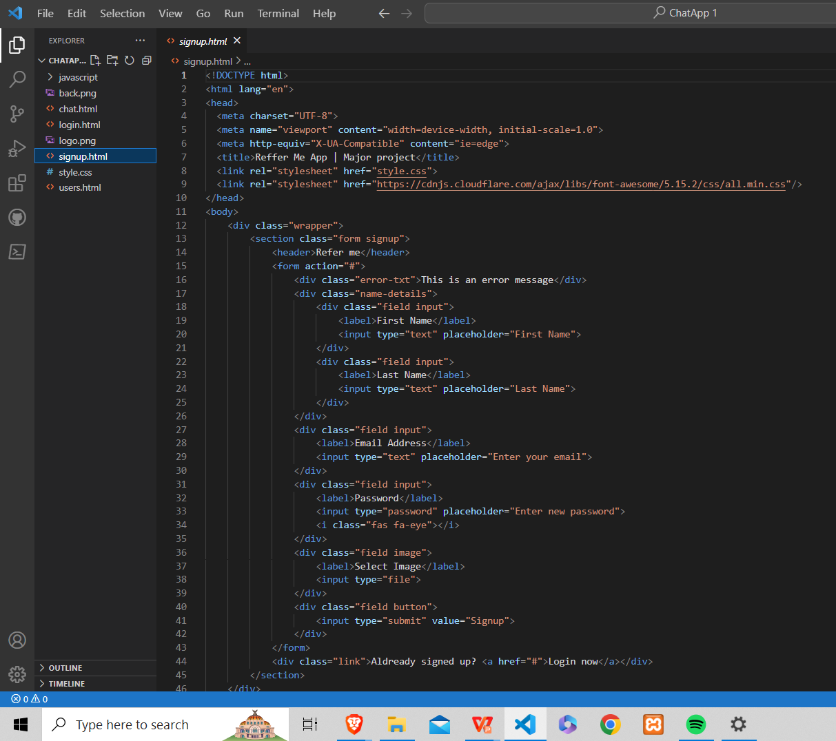
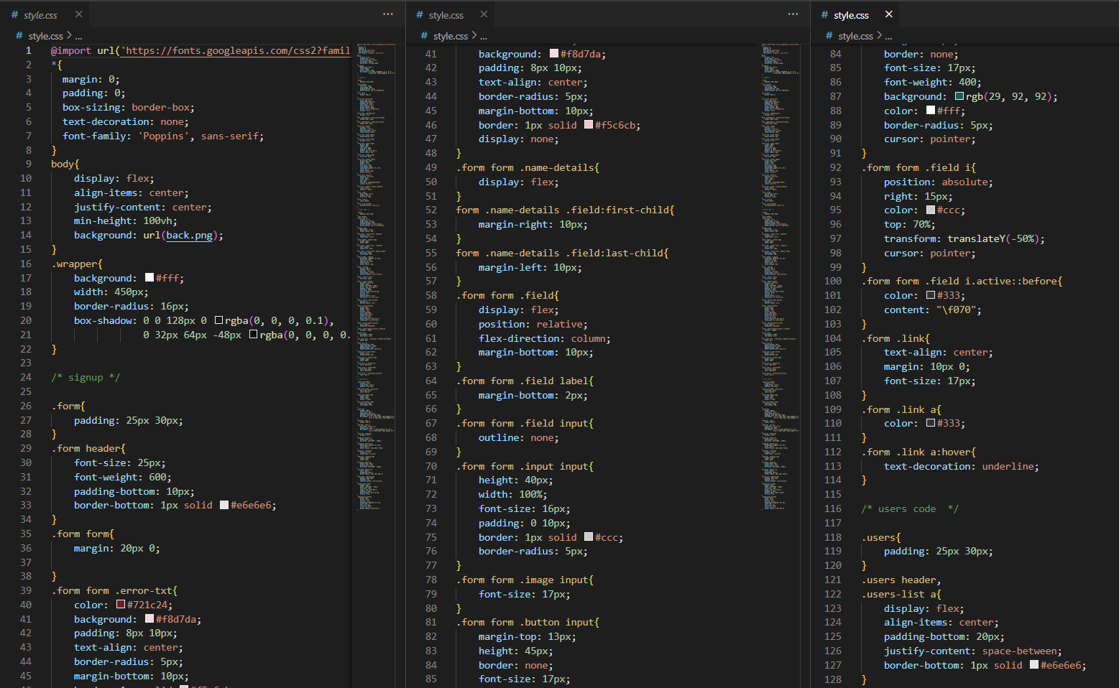
MODULE:1
Step:1 Creating Front-End for the forum application
Signup.html
Style.css

Slide 10
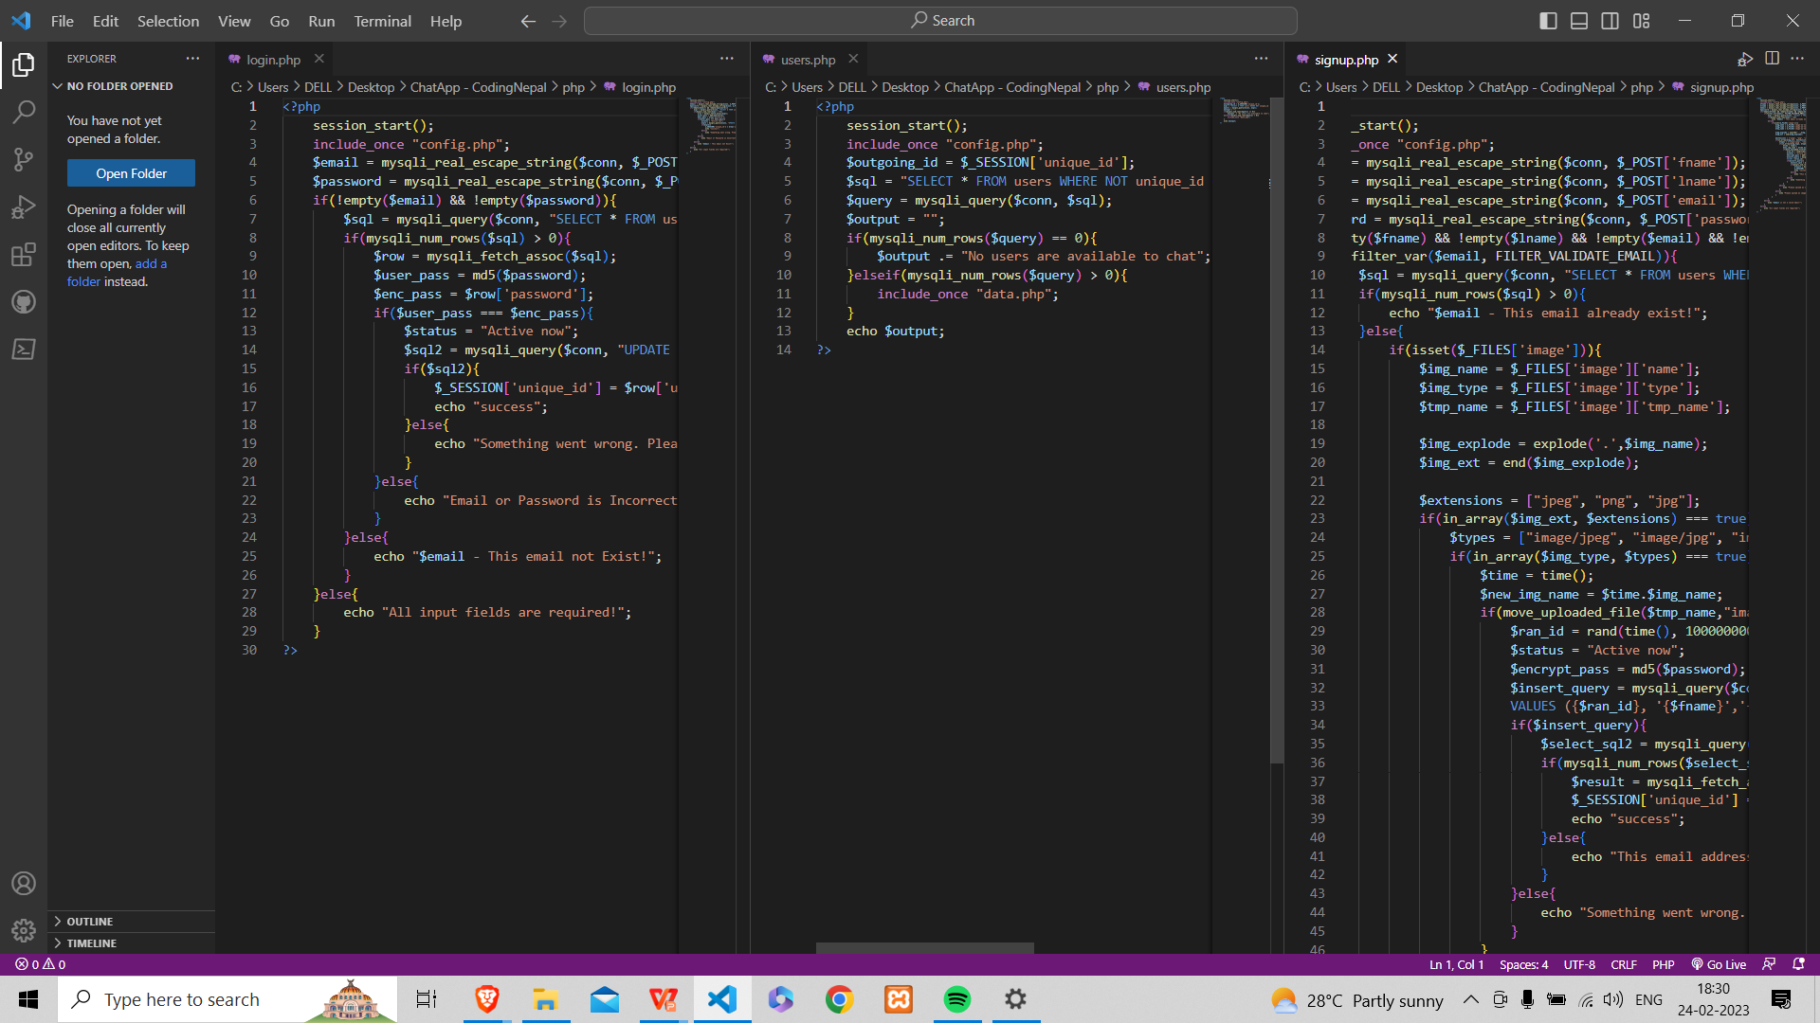
Step 2: Connecting the Back-end with php
PhpMyAdmin has been used as primary database to store the users information.

Slide 11
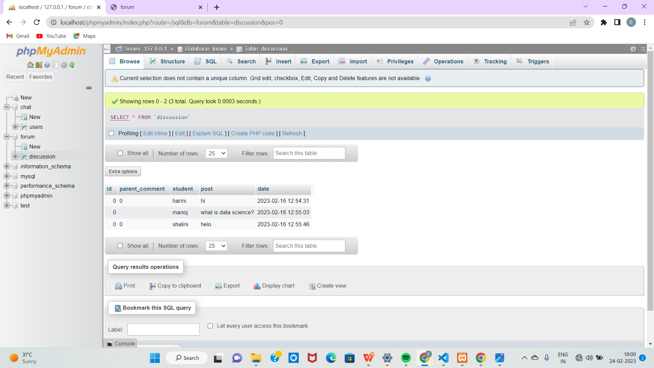
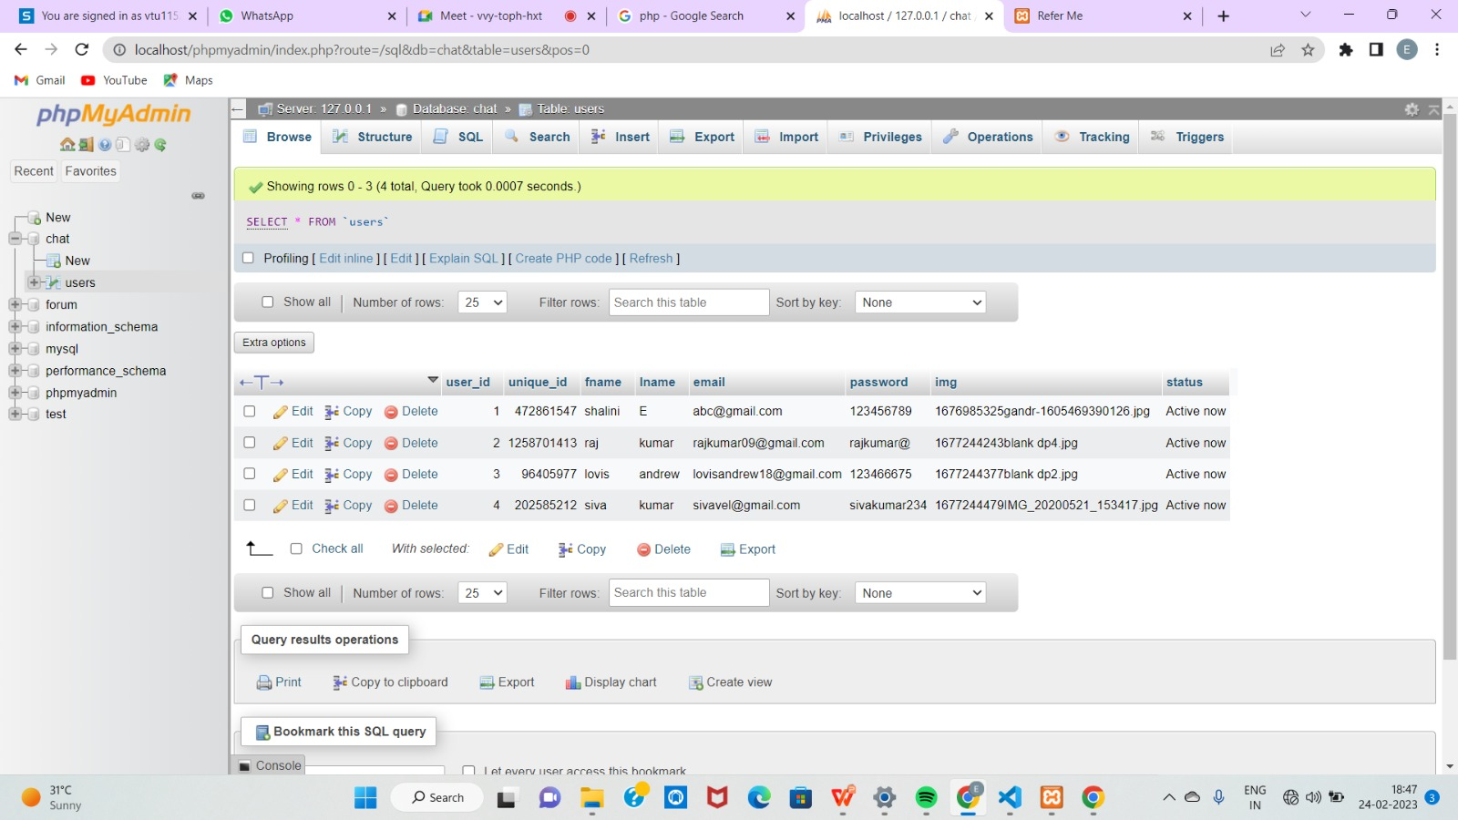
Step:3 Users data has been stored in phpMyAdmin database

Slide 12
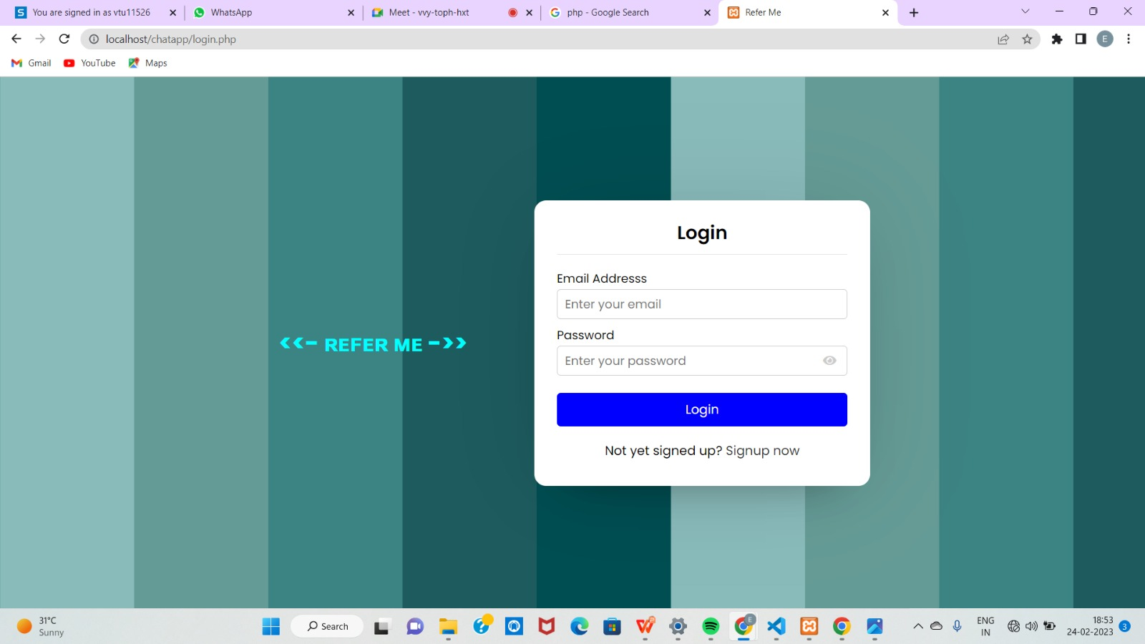
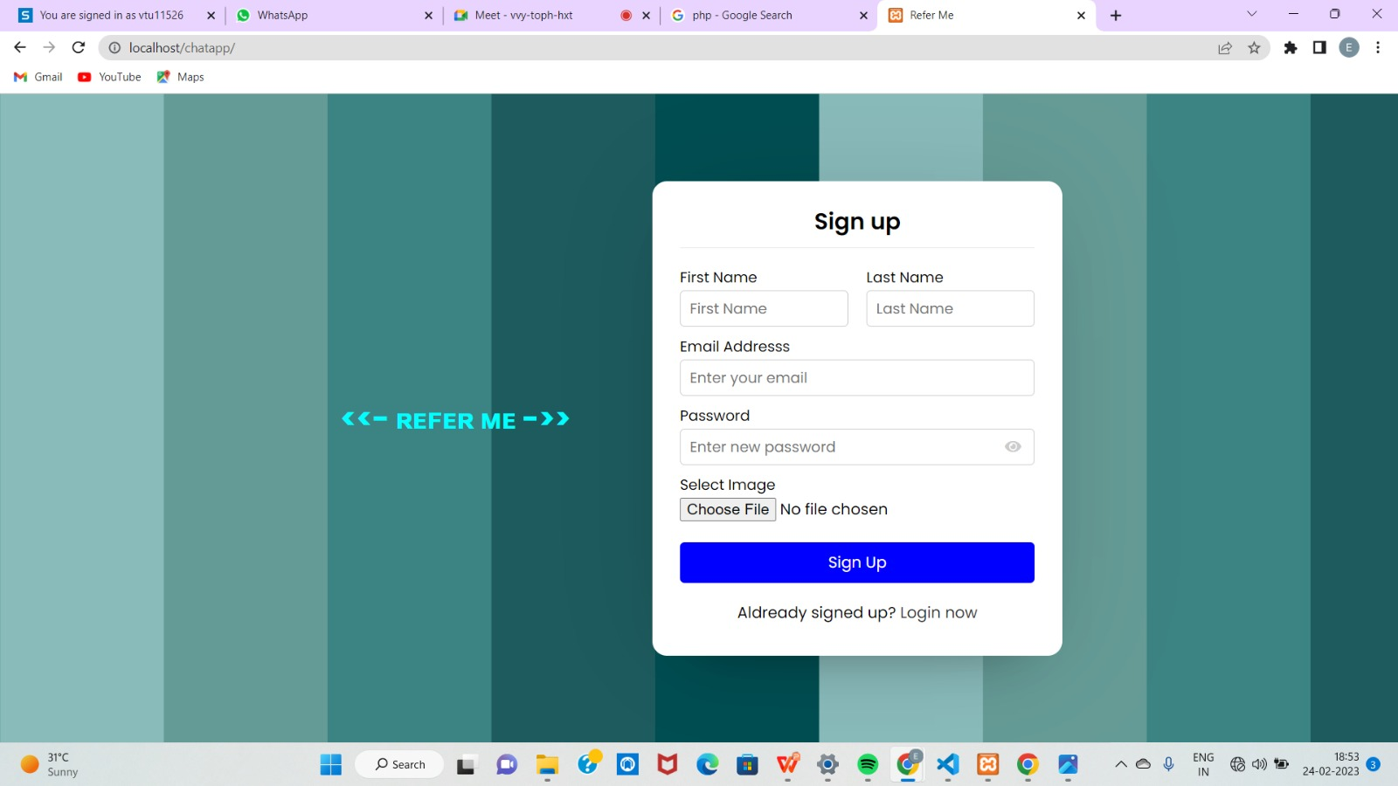
Step 4: Output
login page
signup page

Slide 13
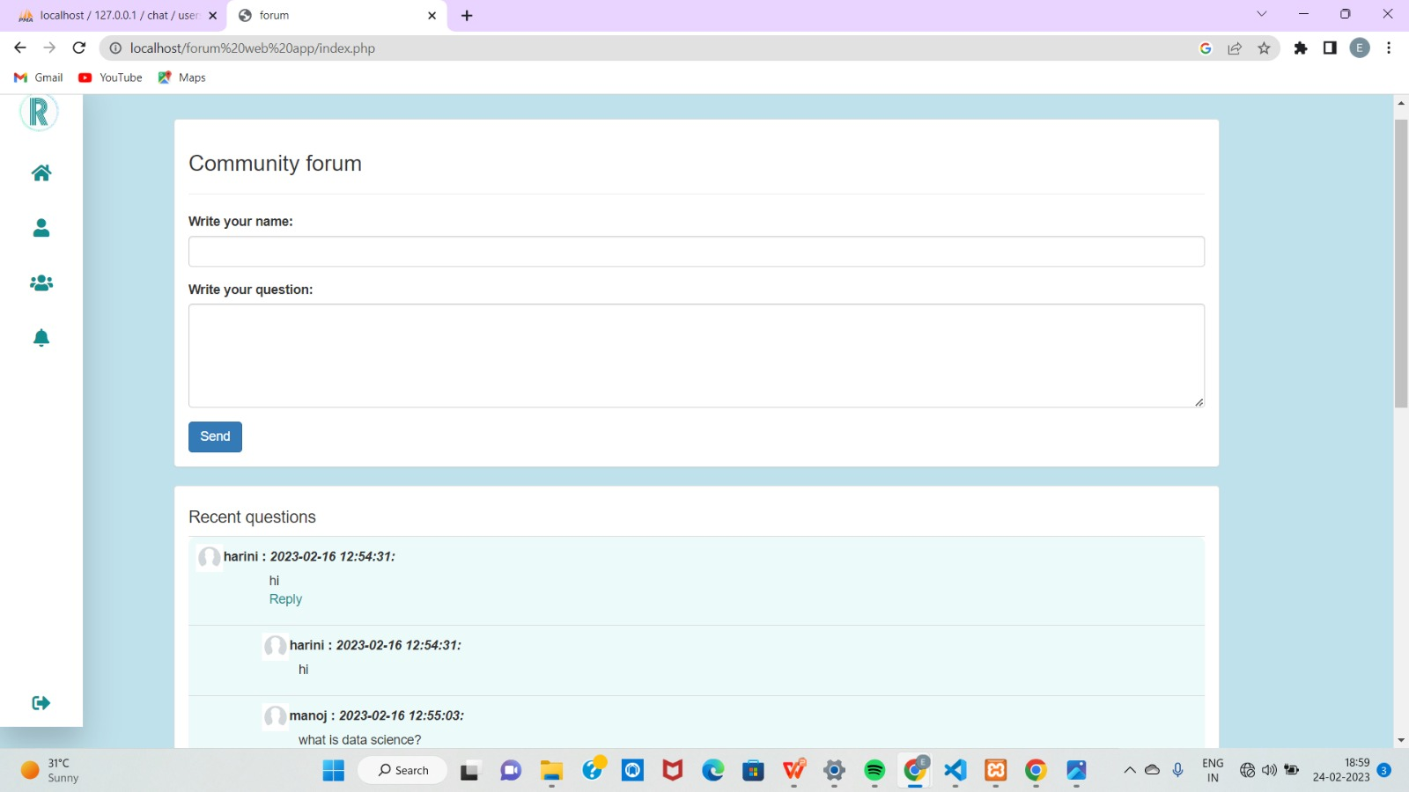
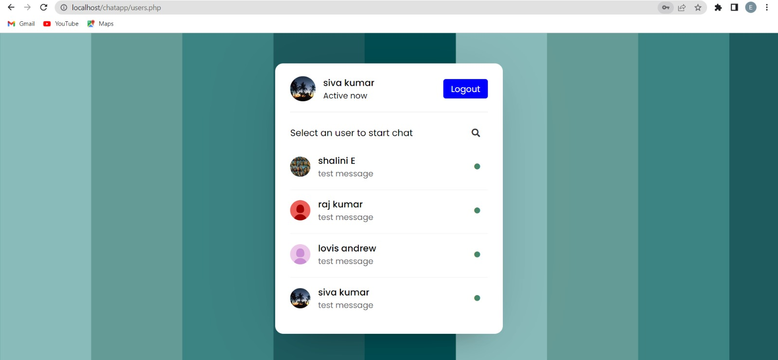
Home page
available users

Slide 14
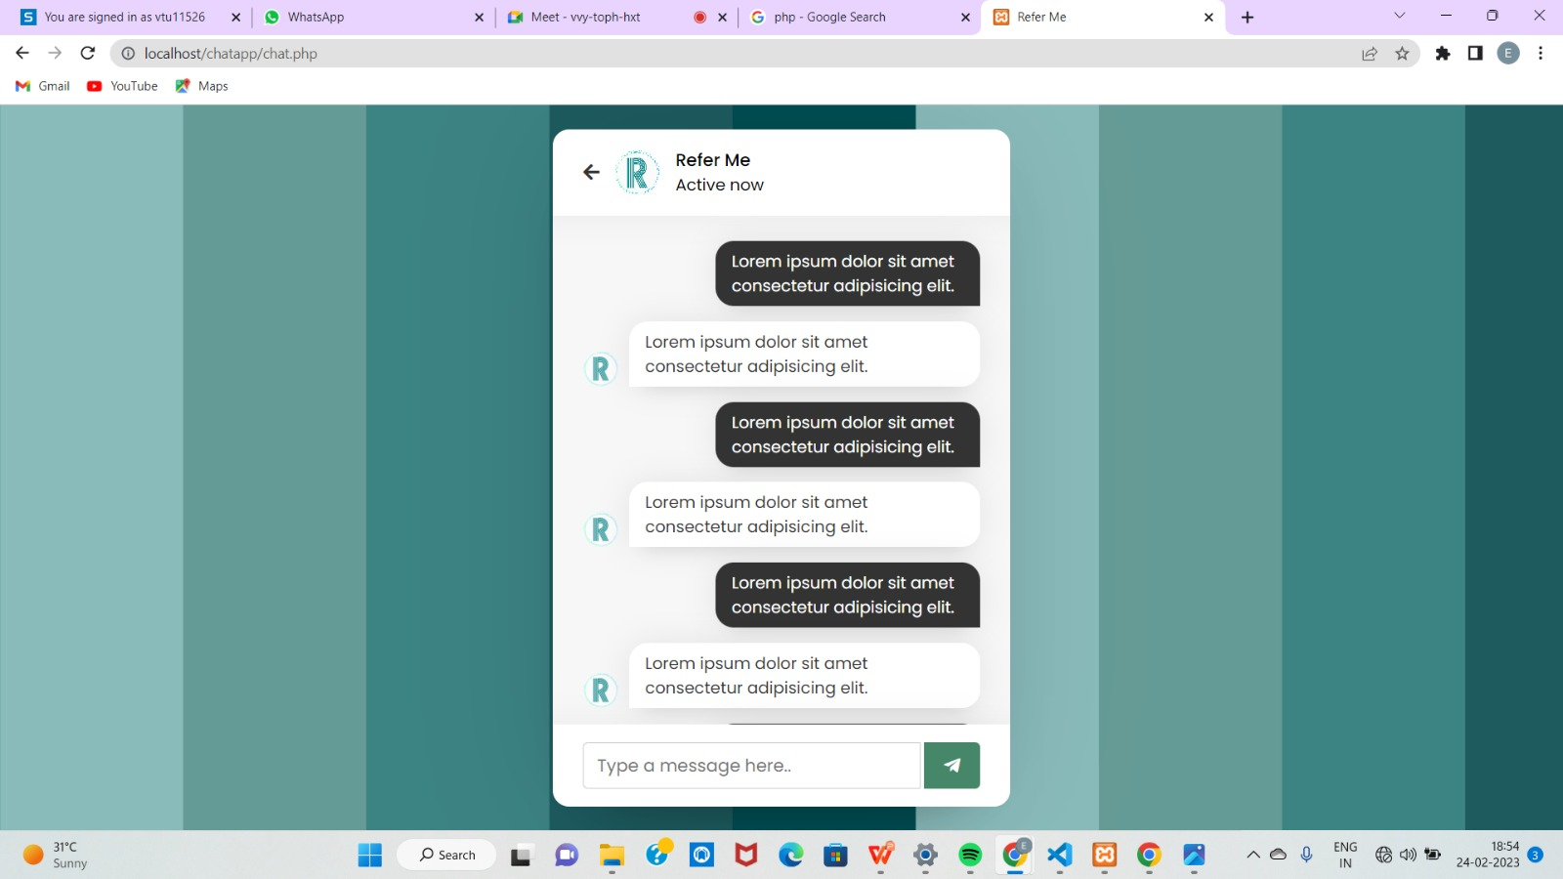
chat page

Slide 15
IMPLEMENTATION
ARCHITECTURE DIAGRAM
DATA FLOW DIAGRAM
ER DIAGRAM

Slide 16
ARCHITECTURE DIAGRAM
User BFF
Login | Group Discussion | Chat Box
phpMyAdmin
MariaDB Server
phpMyAdmin(For app database)
User collection

Slide 17
DATA FLOW DIAGRAM
User is forwarded to the main page of the application
User clicks the login button to enter into the application
process
Log in
User can post their queries
Application database
User can solve the queries
Group discussion
content moderation
User can chat with other individual user to clarify their doubts
Chat box

Slide 18
ER- DIAGRAM
Email address
user
Password
User Name
Check
Sign up
Email
Login
password
Success
User image
Try again
Disscuss
Main Page
Post
Group discussion
Chat box
Personal discussion
Reply
Log out

Slide 19
CONCLUSION
The online disscusion forum application is to serve as a channel through which the students can voice their opinions and can also clarify their doubts by viewing the previous conversation based on the topic. The forum also ensures the participation of the students in various activities and events to create a healthy environment.

Slide 20
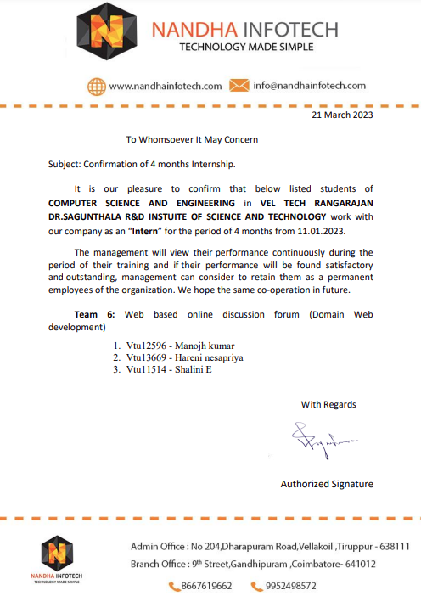
OFFER LETTER SOFT COPY/SCANNED COPY

Slide 21
INDUSTRY DETAILS
Industry Guide Name : Nandha Infotech
Industry Mobile Number : 9487184325
Industry Guide Mail ID : shiju@nandhainfotech.com
Industry Address : 89/99 NGN St, Siddhapudur, New Siddhapudur, Tamil Nadu 641044
Time line/Duration given by Industry for completion of Project : 4 Months(Eg. Jan 23-Apr 23)

Slide 22
REFERENCES
Muhammad, S.K; Irfanullah, K; Siraj, -D; Hafiz ,M.I; Rafid,K and Rahimullah, J. (2015). The Impacts of ICT on the students’ Performance: A Review of Access to Information. Research on Humanities and Social Sciences, 5 (1): 85-94.
Salako, E. A; Solomon, A.A; and Muhammed, B. A. (2015).Perception of Students on Computer Utilization and Academic Performance in the North-Central Geopolitical Zone of Nigeria. I.J. Modern Education and Computer Science, 4: 53-60.
Mashael, N.A; Heba, M; Ayham, F, and Waleed, A. (2015). Web 2.0 in Education: the Impact of Discussion Board on Student Performance and Satisfaction. Turkish Online Journal of Educational Technology, 14 (2): 247-258.
Bechmann, J., & Weber, P. (2016). Cognitive presence in collaborative learning: Assessing and improving critical thinking in online discussion forums. Interactive Technology and Smart Education, 13(1), 52-70.
Awofeso, N., Hassan, M., & Hamidi, S. (2016). Individual and collaborative technologymediated learning using question & answer online discussion forums--perceptions of public health learners in Dubai, UAE. Open Learning, 31(1), 54-63.

Slide 23
Stoerger, S., & Krieger, D. (2016). Transforming a large-lecture course into an active, engaging, and collaborative learning environment. Education for Information, 32(1), 11-26. doi:10.3233/EFI-150967`
Southern New Hampshire University. (2017). Research guides: asynchronous discussion resource guide: providing feedback. Libguides.snhu.edu. Retrieved 10 October 2017, from http://libguides.snhu.edu/c.php?g=92441&p=596049
Zuheir, K; Hamid, N; and Kyungbin, K. (2017). Types of Interaction in Online Discussion Forums: A Case Study. Journal of Educational Issues,3 (1): 155-159.
Xiaoling, L. (2018). The Effectiveness of Online Discussion Forums and Recommendations for Chinese Higher Education. A Project Submitted in Partial Fulfillment of the Requirements for the Degree of Master of Education, Department of Curriculum and Instruction, University of Victoria.
Jeff, K (2019). 5 Online Discussion Tools Fuel Student Engagement. Retrieved from online via:www.Commonsense.org/education/articles/5-online-discussiontools-fuel-student-engagement.

Slide 24
THANK YOU

